Slide 1
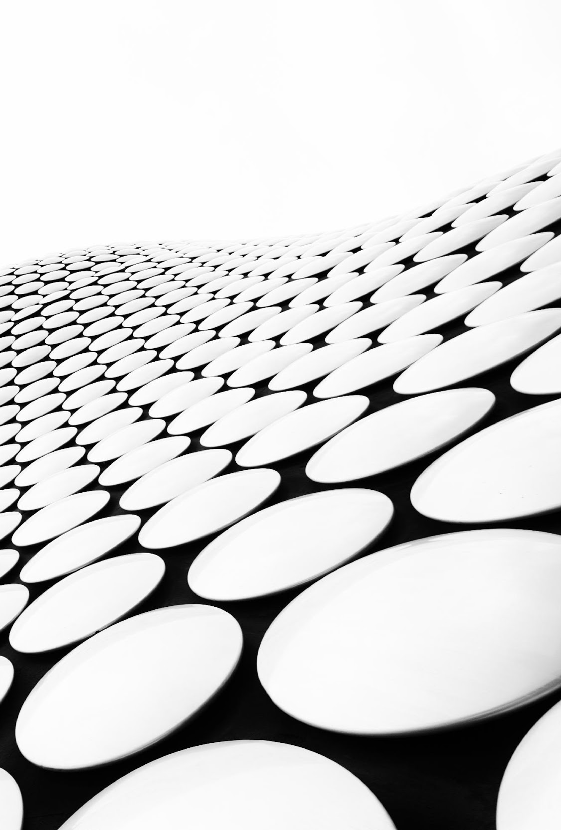
Visual Restoration Solutions
The 652 Crew
Ilsia Saeline Gonzalez, Jose Luis Arrieta, Gabriel Maldonado
Hackathon 2021
Notes:
Greetings judges and fellow peers. My name is Jose Luis Arrieta, my name is Gabriel Maldonado. Our team is called the 652 Crew, and our project is called Visual Restoration Solutions.

Slide 2
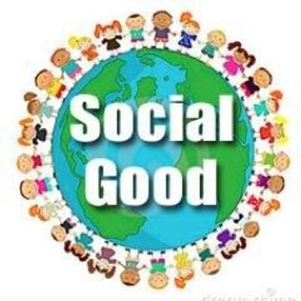
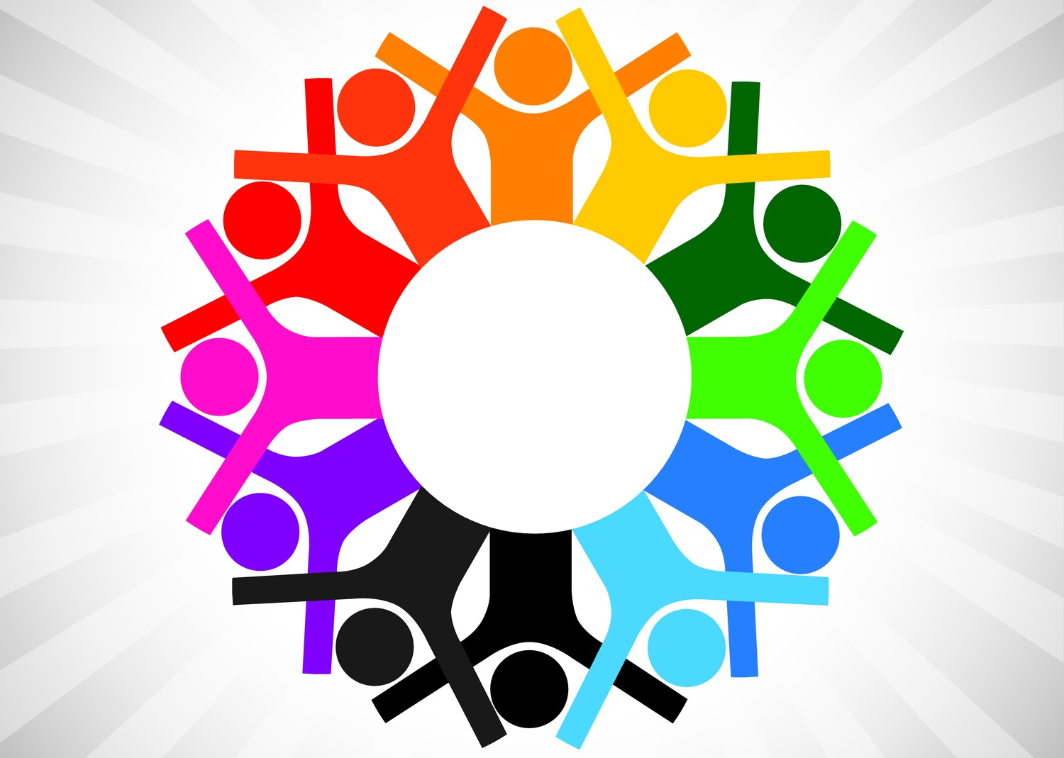
Impact
Social Good
A common good, revolved around real world societal problems.
This project facilitates the theme by providing a solution to the preservation of family culture and traditions.
Inclusivity
Providing equal access to opportunities and resources for people who might otherwise be excluded or marginalized.
This project addresses the difficulties of conserving family customs etc., especially when migrating from one country to another. As well as showing the similarities between people.
Notes:
Social Good
The preservation of family culture can prove to be beneficial for our psychological needs. Surprisingly what seems so simple can actually help in a very complex way. How so? Well, intimate emotional bonds are important to achieving a feeling of elevated kinship
Inclusivity
We all come from somewhere. A place with unique folklore and cuisine. A place that provides a sense of warmth and comfortability. A place that has a special memory. . By enhancing previous photos, we show that we are all the same. Everyone has explicit memories of a favorite location, individual, or event. We strive to unify people by bringing people together through visual storytelling.

Slide 3
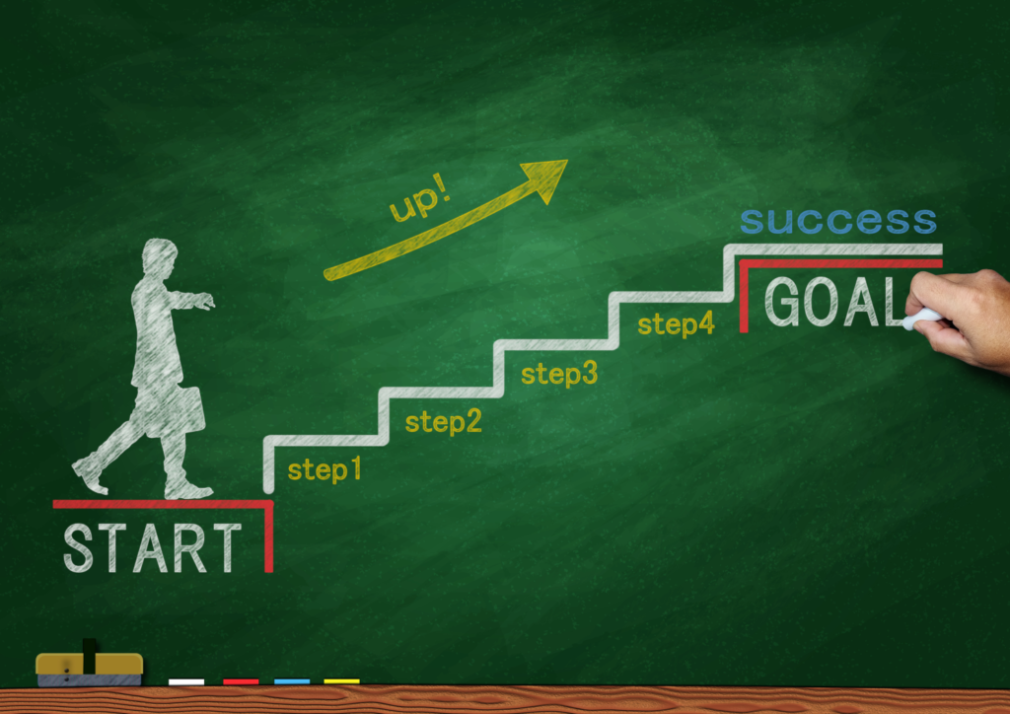
Aspirations
VRS provides a distinct opportunity to bring life to the past. We aim to help cherish memories passed down throughout generations of family photographs.
VRS hopes to strengthen family roots by sharing amplified photos, as well as bring people together by depicting the similarities that band people together.
It is said that thinking about the future can be beneficial, but to reminisce can be true bliss.

Slide 4

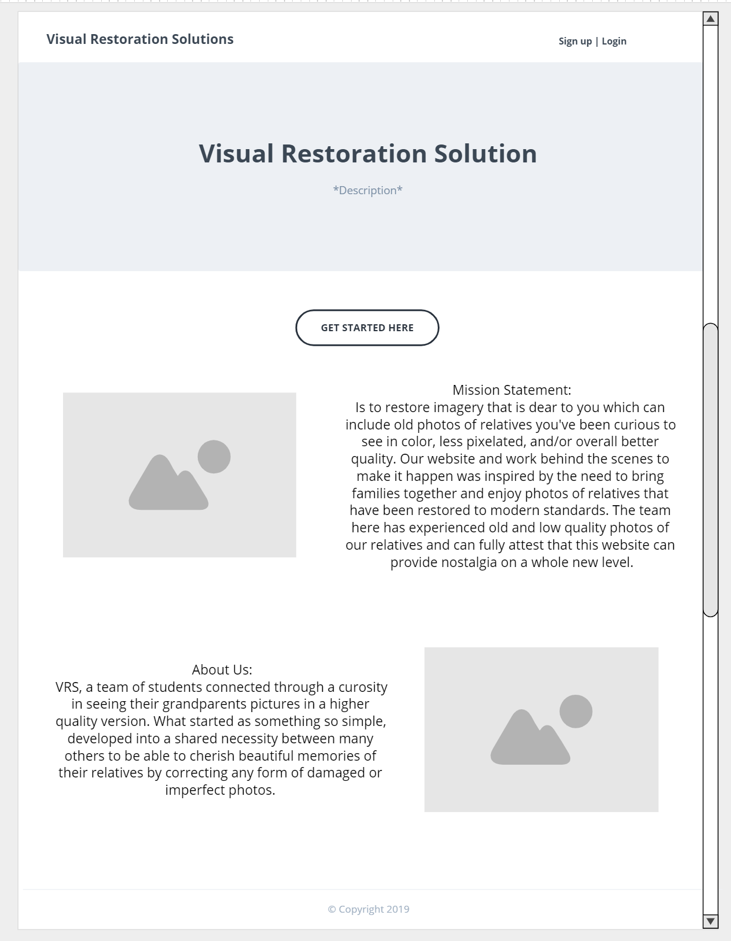
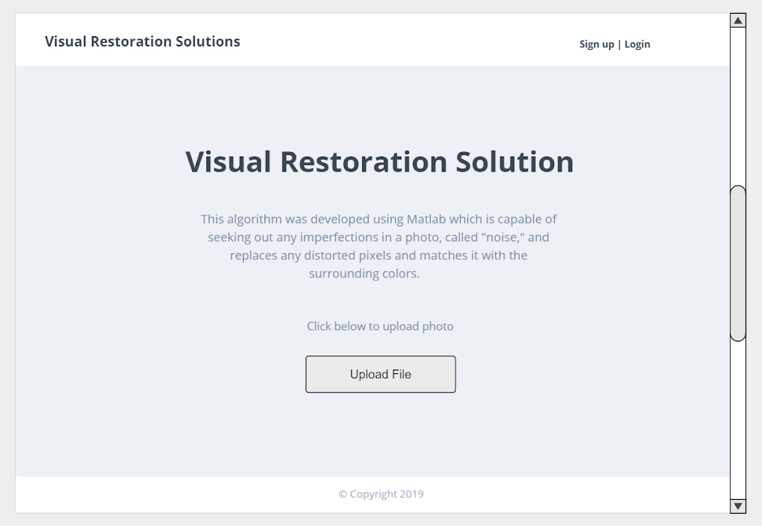
Mockups
Notes:
Mockups. This is the primary design to the website. We aimed to have a website that is user-friendly and aesthetically pleasing. We kept it short and sweet to allow an inviting user interface.

Slide 5


App References
Throughout this project, we used:
Bootstrap to design the actual user interface.
Moqups to construct and be able to easily visualize the code behind our project.
HTML to develop and structure our website, such as being able to upload and edit photos or include other applications directly in our documents.
CSS to help adapt the website to a specific device, in this case a larger screen.
*The separation of HTML and CSS allows for easy maintenance of the site as well as more easily tailored pages depending on the format.

Slide 6
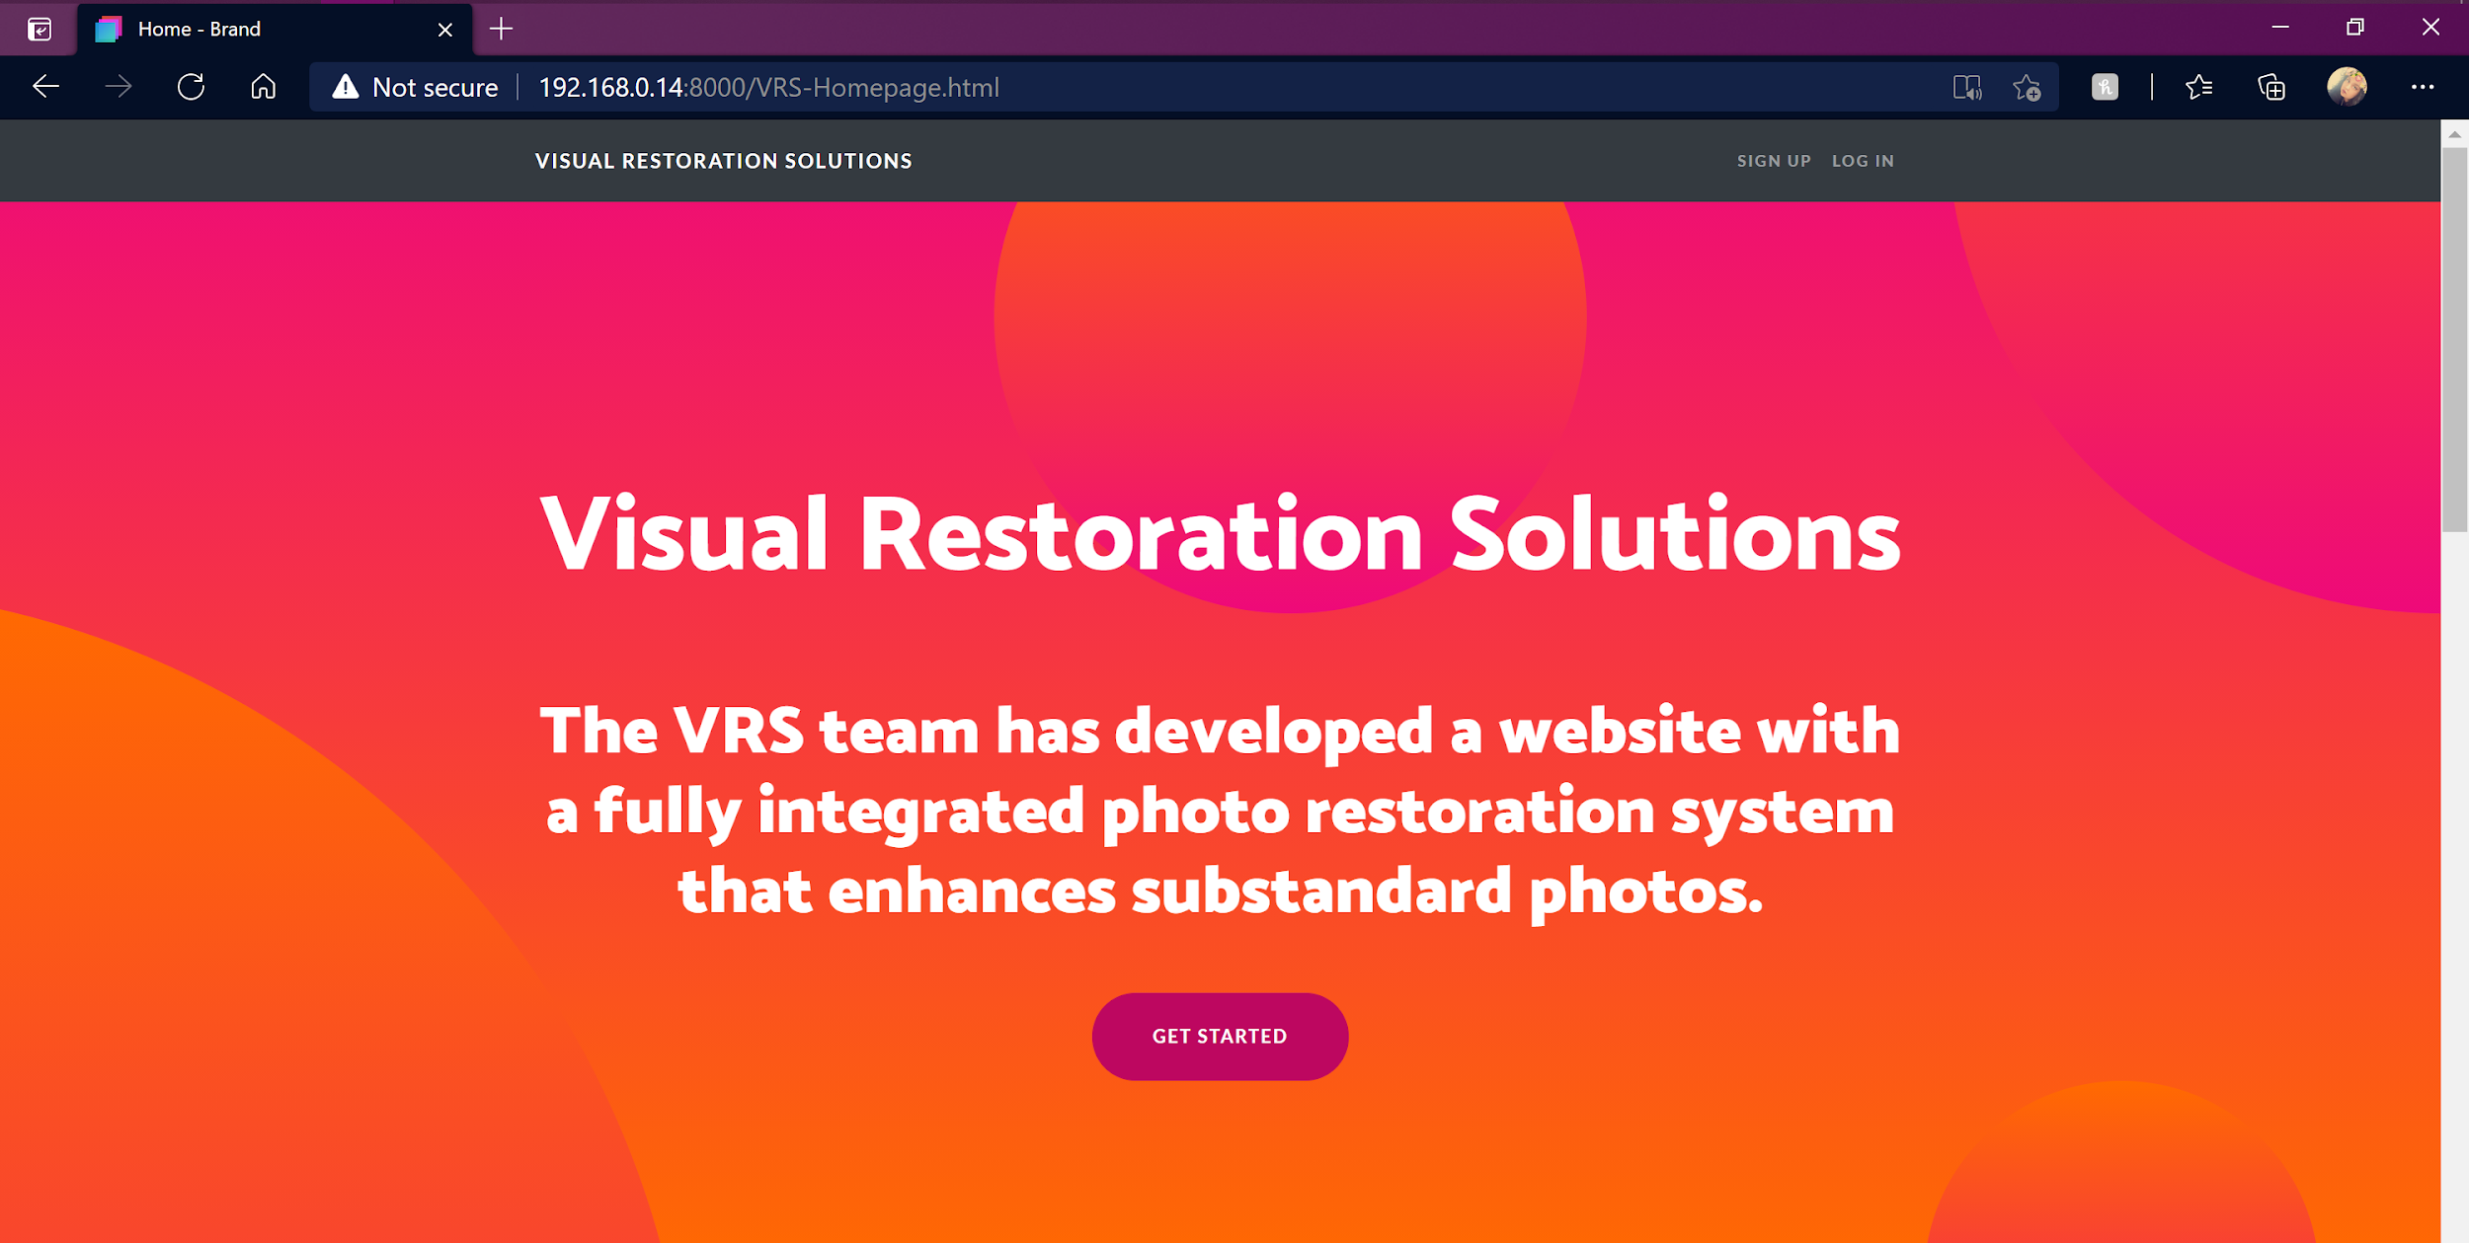
VRS Site Demo
Notes:
Now, a quick demo the VRS website.

Slide 7
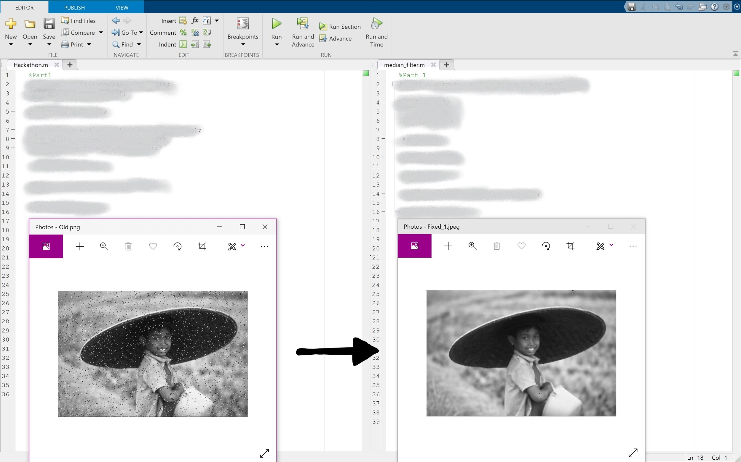
Framework
Notes:
Framework. The image below depicts the backbone of the website. Using a MatLab code, the code calls for the specific image the user wants restored. After about 5 secs, the code presents a new and restored image.

Slide 8
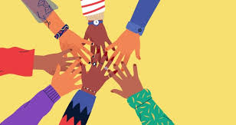
Accomplishments and Struggles
Milestones:
Functionability
The VRS team was able to successfully integrate a photo correcting system that fixes any issues such as blurriness and pixelation.
Struggles
Some team members had absolutely no prior experience with the programs used to develop our website, while others only had experienced using programs such as MatLab.
The learning curve

Slide 9
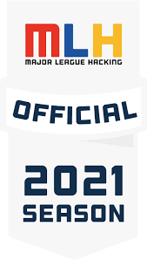
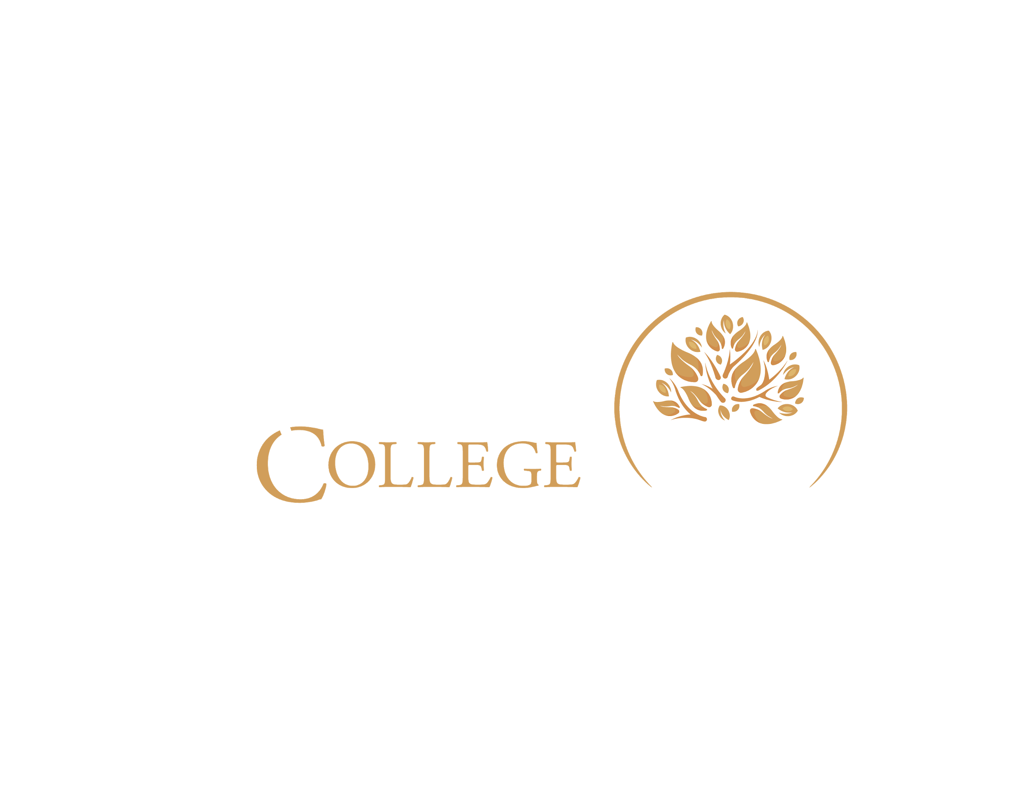

THANK YOU
Gabriel Maldonado
gabriel.maldonado@campus.mccd.edu
Linkedin | Gabe Maldonado
Jose Luis Arrieta
jarrieta2@ucmerced.edu
LinkedIn | Jose Luis Arrieta
Special Thanks to Ilsia Saeline Gonzalez
igonzlaez39@ucmerced.edu
Notes:
Thank you for your time and considerations. Have an amazing day!

